Slide 1
Transaction Management

Slide 2
A transaction is a single logical unit of work which accesses and possibly modifies the contents of a database. Transactions access data using read and write operations.
In order to maintain consistency in a database, before and after the transaction, certain properties are followed. These are called ACID properties.
The transaction can be defined with ACID properties.
Atomicity – All success or none. Consistency – Database constraints should not be violated. Isolation – One transaction should not affect another one. Durability – It should in Database after commit.

Slide 3
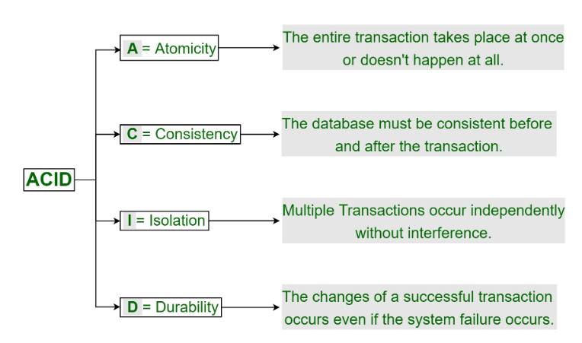

Slide 4
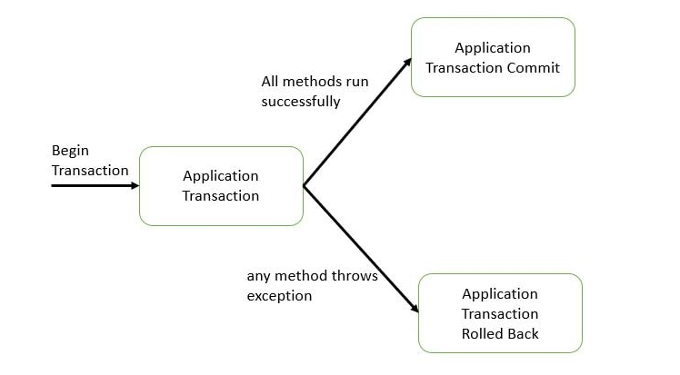

Slide 5
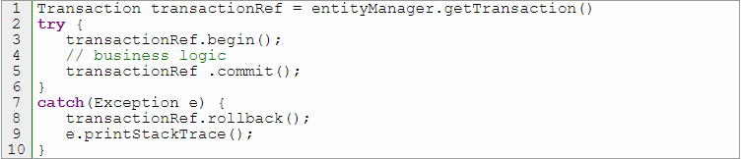
We have the following two operations :-
Commit: If all the operations in a transaction are completed successfully then commit those changes to the database permanently.
Rollback: If any of the operation fails then rollback all the changes done by previous operations.
Different ways of the transaction management-
Programmatic transaction management.
Declarative transaction management.
Programmatic transaction management – Here we need to write some extra code for transaction management. When we say some extra code what does it mean? We need to take care of –
Creating Transaction reference
Begin transaction
Commit or rollback of the transaction
Let’s see sample code –

Slide 6
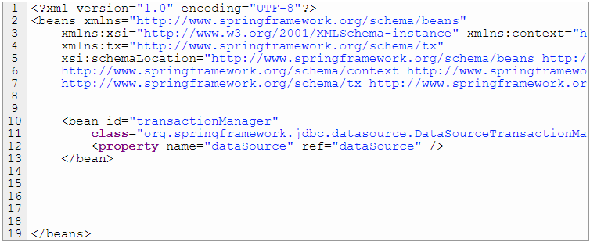
Declarative transaction management – No need to write extra code for getting a transaction, we can use annotations or XML-based approach to manage the transactions and we can avoid unnecessary code. If we use annotation based approach we can use @Transactional and if we use the XML-based approach we need to configure DataSourceTransactionManager or any other transaction manager in XML as a bean. In this article and the next upcoming article, we will see the annotation based approach.
Annotation based declarative transaction management
XML-based declarative transaction management

Slide 7
The @Transactional annotation has a different attribute and corresponding value. We can use those attributes and customized our transaction.
@Transactional(isolation = Isolation.DEFAULT,
propagation=Propagation.REQUIRES_NEW,
readOnly=true,
noRollbackFor =ArithmeticException.class,
timeout = 30000,
rollbackFor = { Exception.class },
rollbackForClassName = {"Exception”})

Slide 8
Propagation defines our business logic ‘s transaction boundary. Spring manages to start and pause a transaction according to our propagation setting.
Propagation.REQUIRED – Support a current transaction, create a new one if none exists.
Propagation.REQUIRES_NEW – Always create a new transaction and suspend the current transaction if already exist.
Propagation.MANDATORY – Support a current transaction, throw an exception if none exists.
Propagation.NESTED – Execute within a nested transaction if a current transaction exists.
Propagation.NEVER – Execute non-transactionally, throw an exception if a transaction exists.
Propagation.NOT_SUPPORTED – Execute non-transactionally, suspend the current transaction if one exists.
Propagation.SUPPORTS – Support a current transaction, execute non-transactionally if none exists.
Propagation.REQUIRED and Propagation.REQUIRES_NEW is frequently used in real-time development

Slide 9
Isolation – isolation can have different possible value as below.
Isolation.READ_UNCOMMITTED – It allows dirty reads, non-repeatable reads, and phantom reads.
Isolation.READ_COMMITTED – Dirty reads are prevented, allows non-repeatable and phantom reads.
Isolation.REPEATABLE_READ – Dirty reads and non-repeatable prevented, phantom reads allowed.
Isolation.SERIALIZABLE – Dirty reads, non-repeatable reads, and phantom reads are prevented.

Slide 10
Dirty reads : A dirty read occurs when a transaction is allowed to read data from a row that has been modified by another running transaction and not yet committed
Non-repeatable read occurs, when during the course of a transaction, a row is retrieved twice and the values within the row differ between reads.
Phantom read occurs when, in the course of a transaction, two identical queries are executed, and the collection of rows returned by the second query is different from the first.

Slide 11
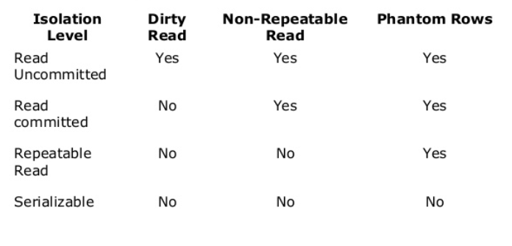

Slide 12
rollbackFor – We can define zero, one or multiple exceptions for which we want our transaction to be rollbacked
@Transactional(rollbackFor = {RuntimeException.class})
noRollbackFor – We can define zero, one or multiple exceptions for which we don’t want our transaction to be rollbacked.
@Transactional(noRollbackFor = {RuntimeException.class})
rollbackForClassName – We can define zero, one or multiple exceptions as String for which we want our transaction to be rollbacked..
@Transactional(rollbackForClassName = {“NullPointerException”})
noRollbackForClassName – We can define zero, one or multiple exceptions as String for which we don’t want our transaction to be rollbacked..
@Transactional(noRollbackForClassName = {“NullPointerException”})
readOnly – Its value can be true or false. @Transactional(readOnly = false)
Note that – by default, rollback happens for runtime, unchecked exceptions only. The checked exception does not trigger a rollback of the transaction. We can, of course, configure this behavior with the rollbackFor and noRollbackFor annotation parameters.

Slide 13
Transactions and Proxies
At a high level, Spring creates proxies for all the classes annotated with @Transactional – either on the class or on any of the methods. The proxy allows the framework to inject transactional logic before and after the running method – mainly for starting and committing the transaction.
What's important to keep in mind is that, if the transactional bean is implementing an interface, by default the proxy will be a Java Dynamic Proxy. This means that only external method calls that come in through the proxy will be intercepted. Any self-invocation calls will not start any transaction, even if the method has the @Transactional annotation.
Another caveat of using proxies is that only public methods should be annotated with @Transactional. Methods of any other visibilities will simply ignore the annotation silently as these are not proxied.
If we don’t provide any value for rollbackFor or we don’t mention rollbackFor as a parameter with @Transnational annotation, spring provides default rollback for RuntimeException/unchecked exception and Error.

Slide 14
Reference
https://netsurfingzone.com/spring/spring-transaction-management-basic/
https://beginnersbook.com/2015/04/acid-properties-in-dbms/
https://stackoverflow.com/questions/11043712/what-is-the-difference-between-non-repeatable-read-and-phantom-read/51123574

